Slide 1
AI Pill Image Verification
Triet Pham

Slide 2
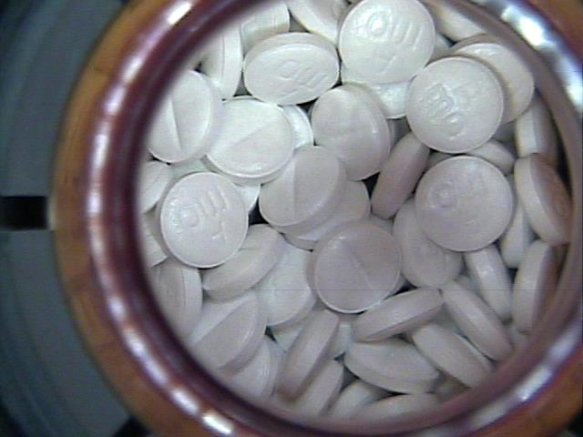
Use Case
Leverage machine learning for pill verification in pharmaceutical factory to enable automation.
Metoprolol Succinate
Detection Model
Confidence level:
0.9985362
Image from factory camera

Slide 3
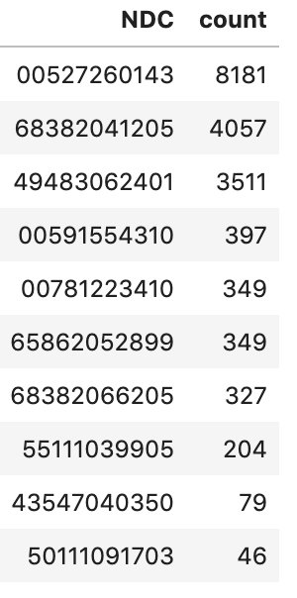
Approach: CNN Models
CNN: A type of neural networks used for image classification.
Trained and tested with ~17,000 images across 10 different drug types.
Training time: ~5 minutes on GPU
Metoprolol Succinate
Omeprazole
Metformin

Slide 4
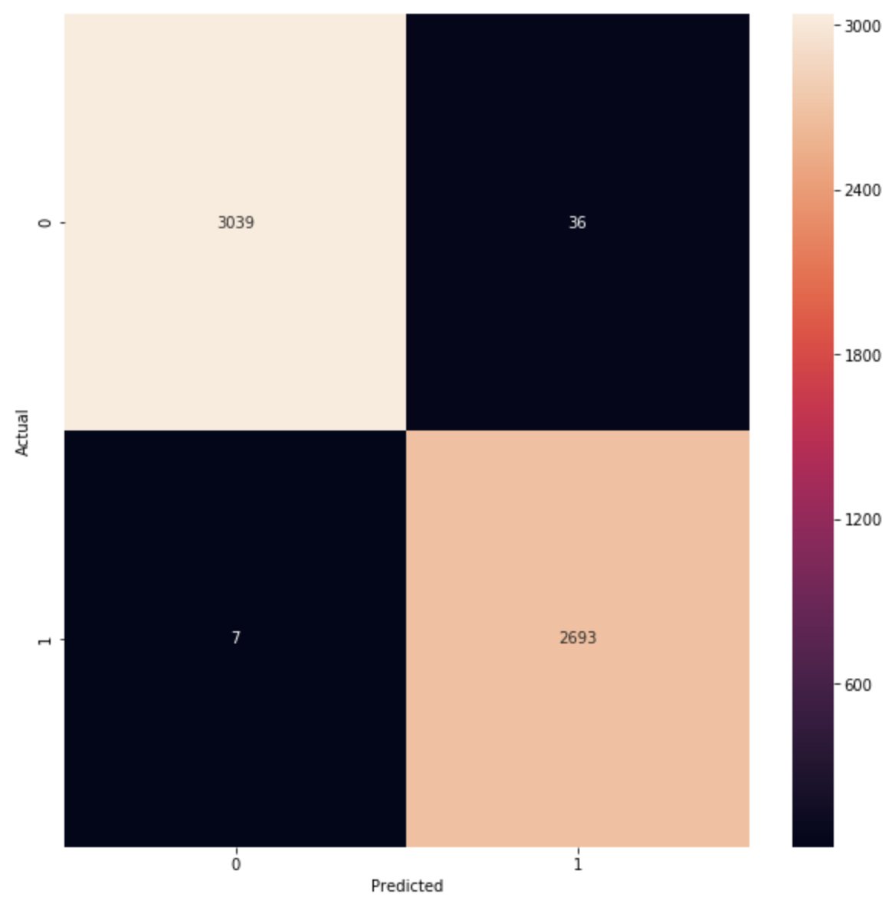
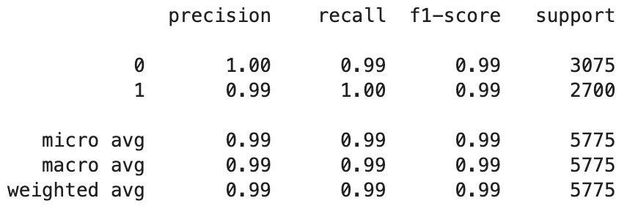
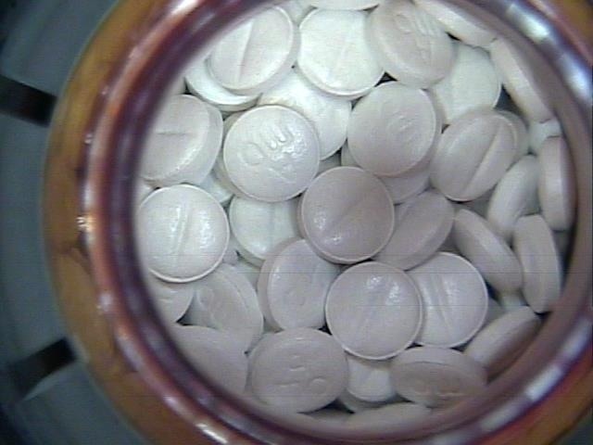
Binary CNN for Metoprolol Succinate Metrics

Slide 5
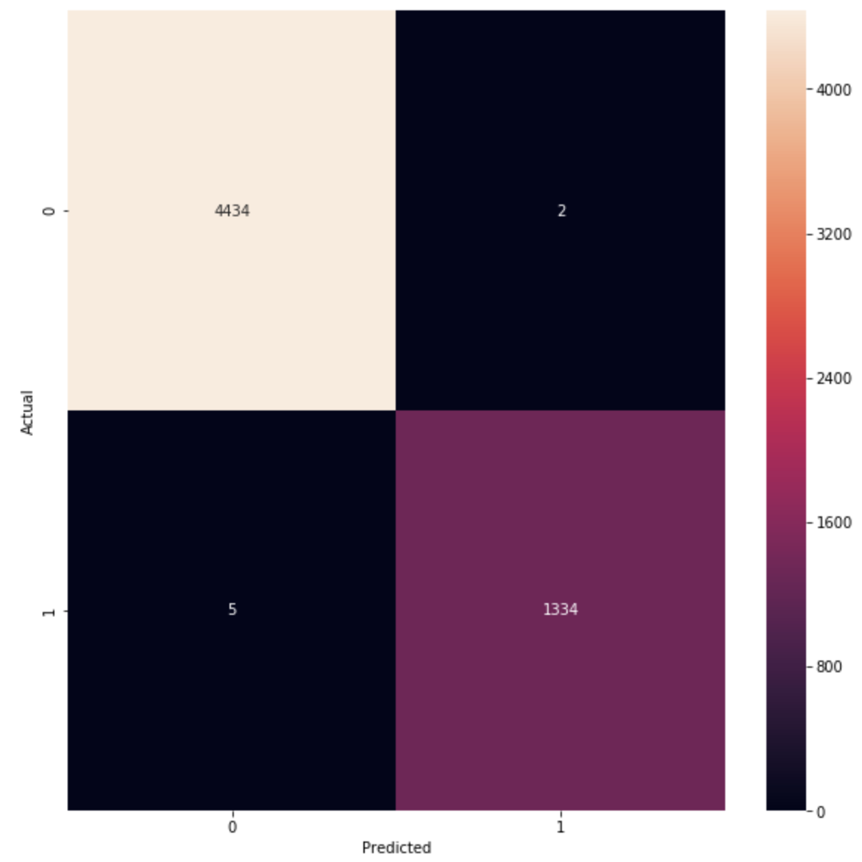
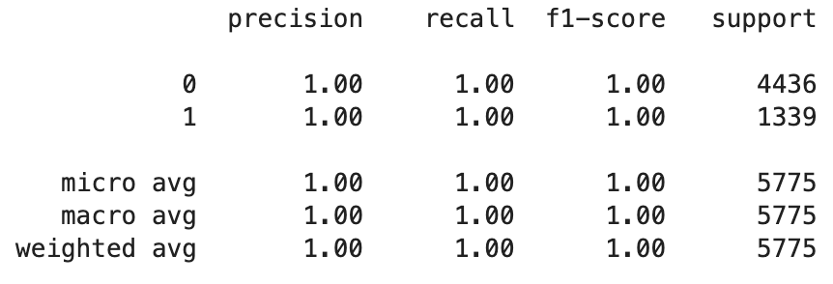
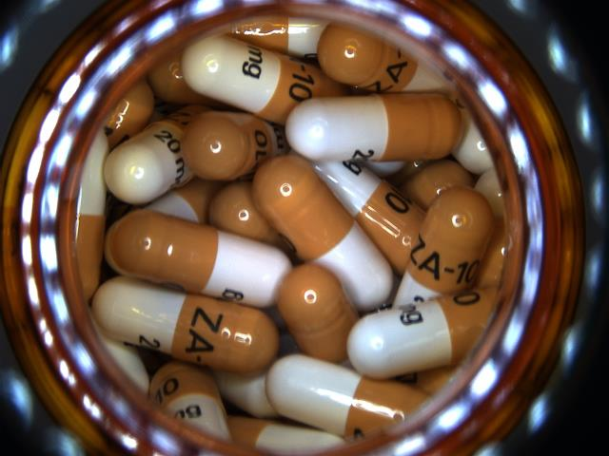
Binary CNN for Omeprazole Metrics

Slide 6
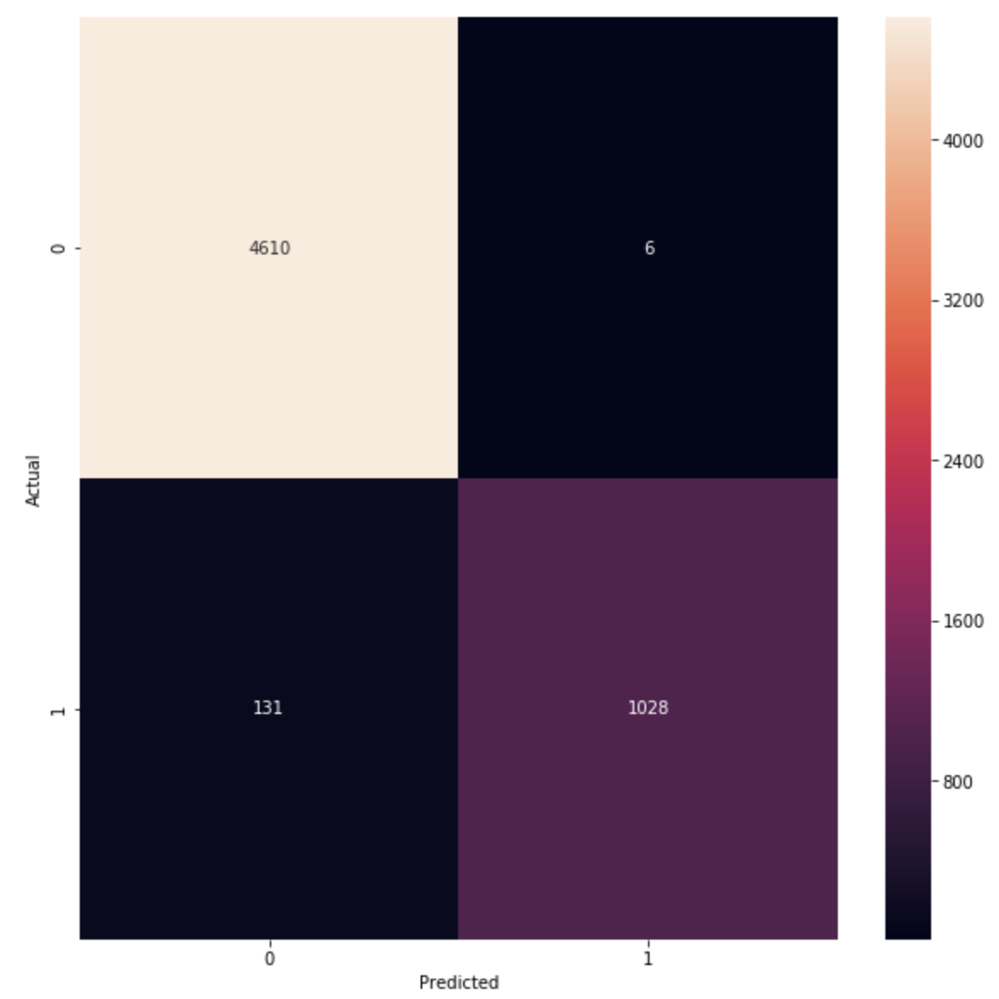
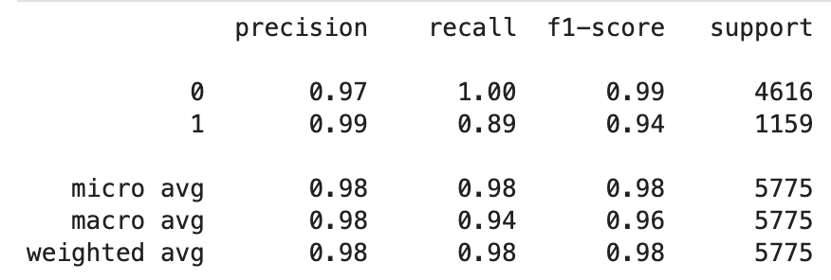
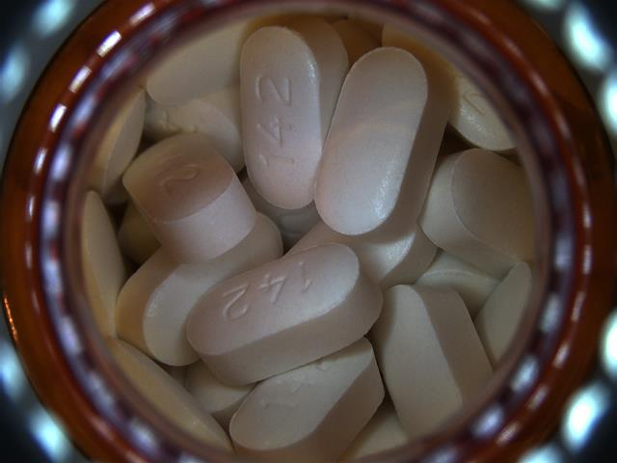
Binary CNN for Metformin Metrics

Slide 7
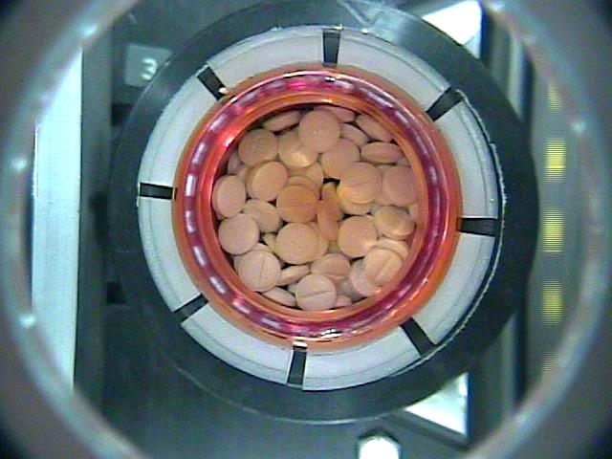
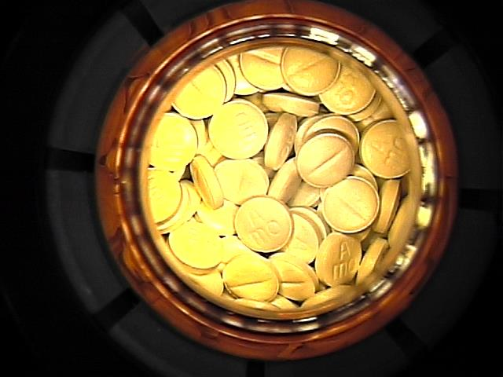
Metoprolol Succinate Confidence Levels
Scenarios under different camera conditions
Different lighting
Zoomed out
Slightly uncentered
Metoprolol Succinate
Metoprolol Succinate
Metoprolol Succinate
Confidence level:
0.9998367
Confidence level:
0.9985362
Confidence level:
0.9579251

Slide 8
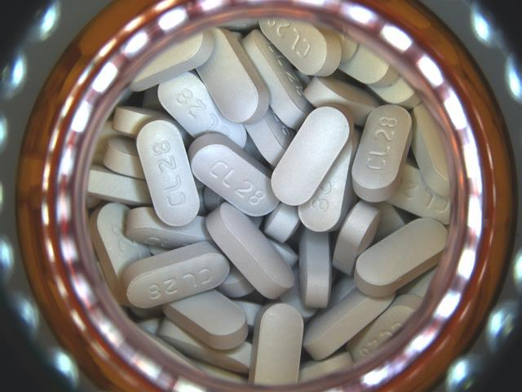
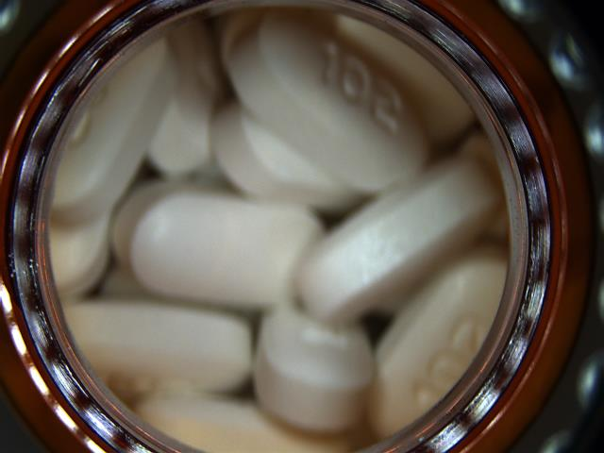
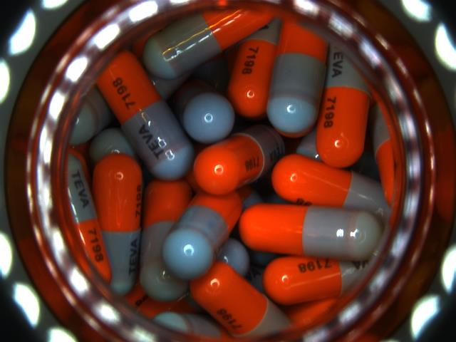
Metoprolol Succinate Confidence Levels
Examples of NOT Metoprolol Succinate
The model has
seen this drug
The model has not
seen this drug
The model has not
seen this drug
Metformin
Fluoxetine
Memantine Hydrochloride
Confidence level:
0.0001270
Confidence level:
0.0000014
Confidence level:
0.8855288

Slide 9
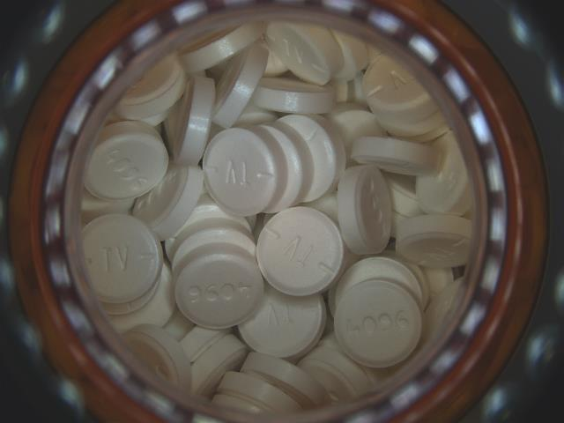
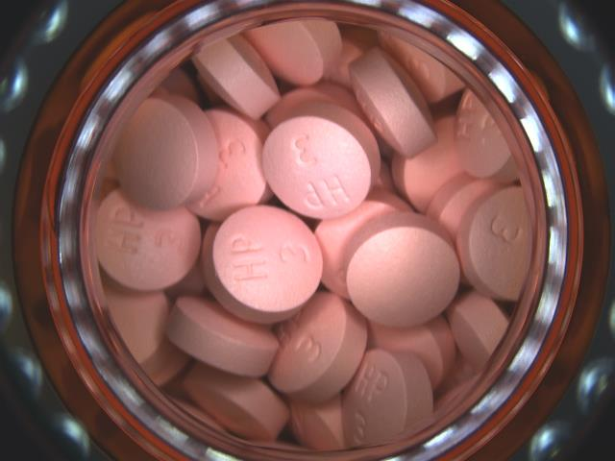
Metoprolol Succinate Confidence Levels
Other drugs that resembles Metoprolol Succinate
The model has not
seen this drug
The model has not
seen this drug
Baclofen
Hydralazine Hydrochloride
Confidence level:
0.7408031
Confidence level:
0.4727986

Slide 10
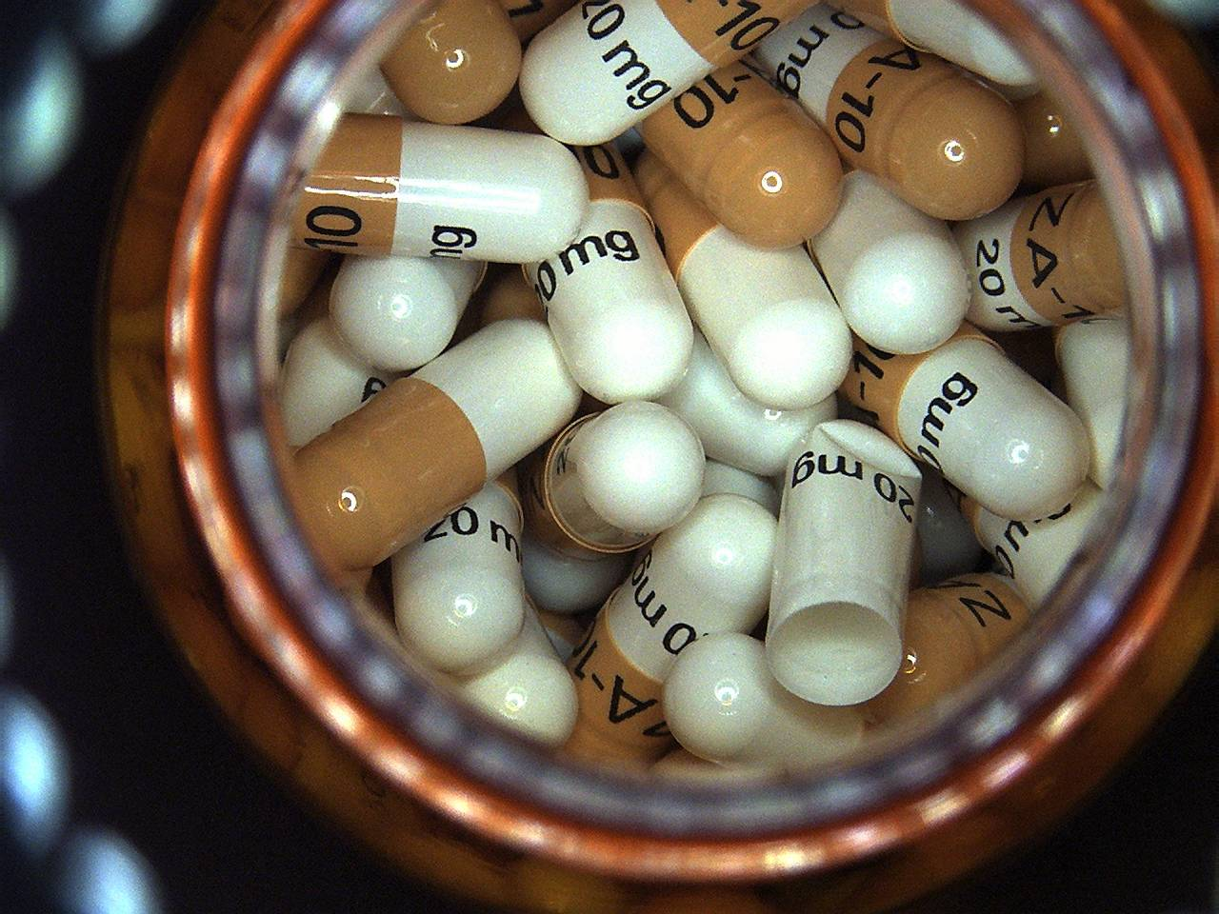
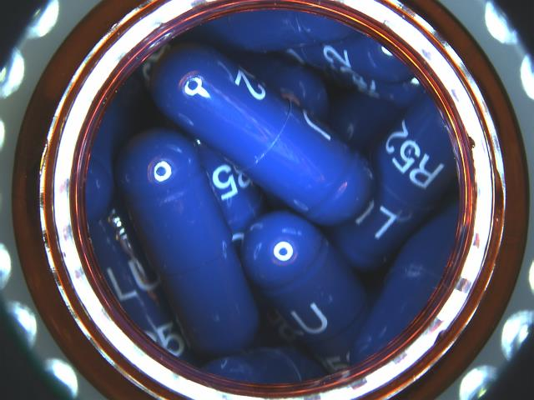
Confidence ≠ Probability of being Right
The model has not
seen this drug
A. 90%
B. 10%
Q. Which pill is this?
Model: “I’m 90% confident it’s A.”

Slide 11
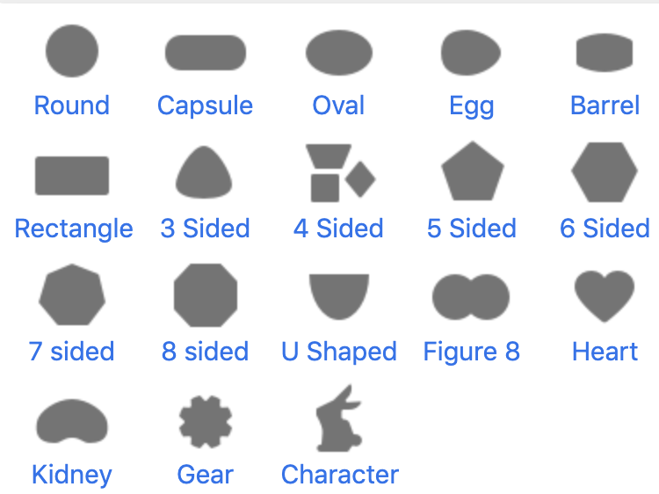
Limitations of Current Work & How to Potentially Solve Them
Limitation #1: The testing metrics only speak for how well the model would perform under an environment where only those 10 types of pills exists.
Solution: For the metrics to be reflective of production-like environment, we can train the models on a wider range of pills (10 is too little). Having a wider range of pills help the model generalize the features of pills.
Pills have 3 main characteristics: Shape, Color, Imprint
The idea is to provide a range of pills that cover these characteristics well.

Slide 12
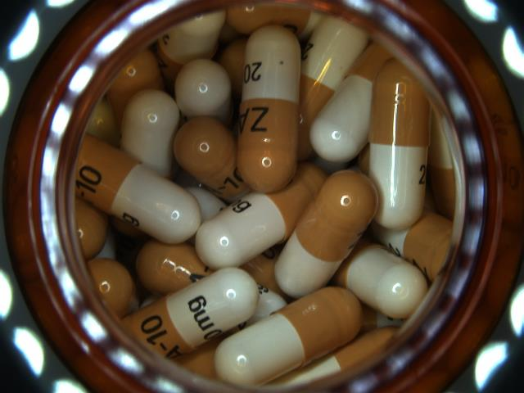
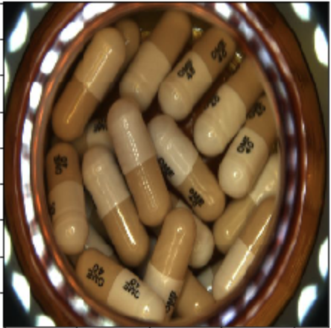
Limitations of Current Work & How to Potentially Solve Them
Limitation #2: Even though very few occurrences, there are still false positives (e.g. when the model positively identify a drug as Omeprazole, but actually it’s not). This can have bad consequences in a pharmaceutical setting (mis-prescribing medicine).
Actual
Omeprazole
False Positive
that we found
Omeprazole
Solution: This can be mitigated by raising confidence threshold, which will increase precision but sacrifice some recall. In other words, the model will be wrong less often but it will catch less cases.
For example, we can set the threshold to achieve 99.99% precision where we will only see 1 wrong classification in 10,000 positively identified images.

Slide 13
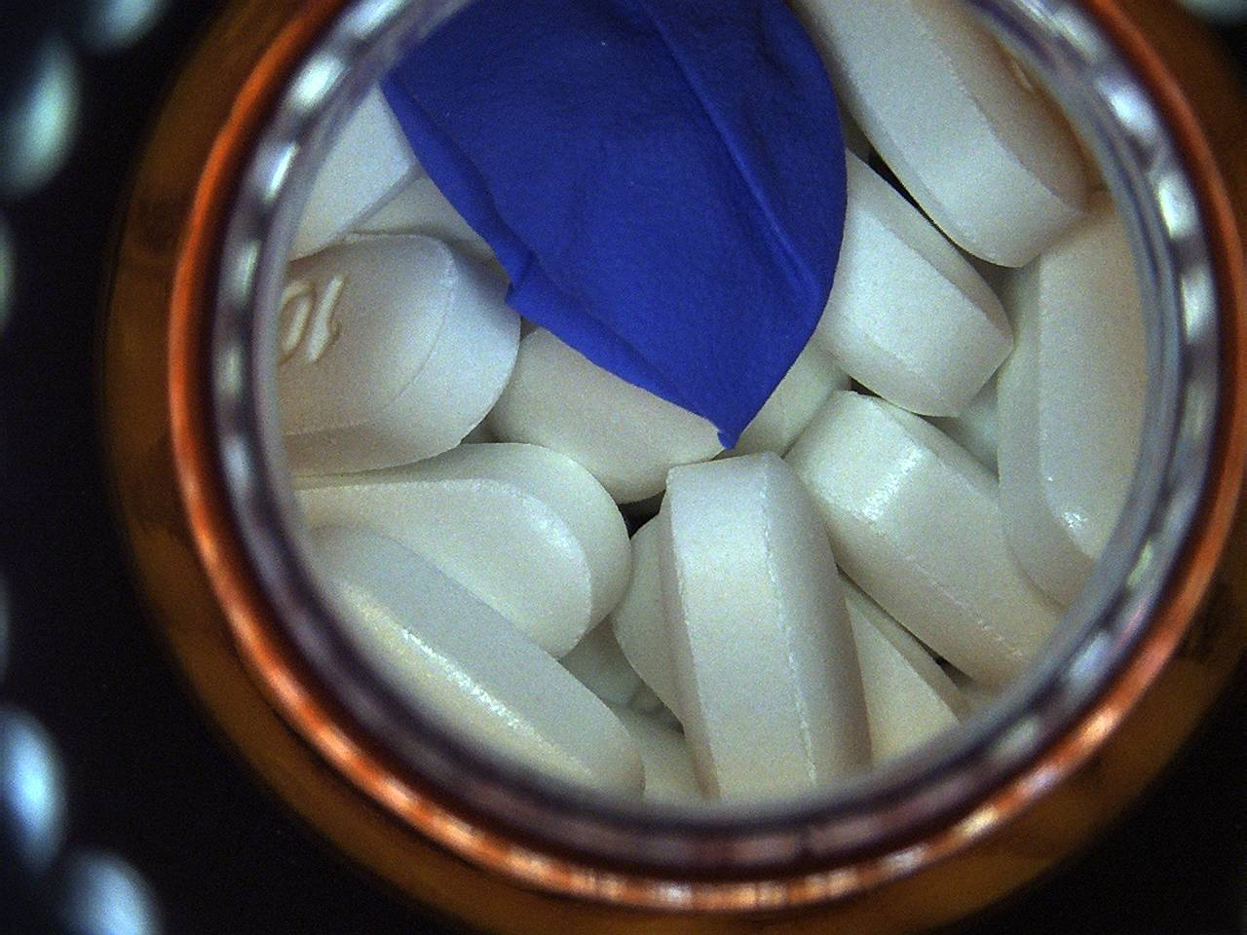
Limitations of Current Work & How to Potentially Solve Them
Limitation #3: Current models were not designed to detect foreign objects, defected pills, or mixed vials.
Solution: We can build models that evaluate smaller individual sections/objects from the image simultaneously and then consolidate the evaluation at a vial-level.
To detect foreign objects and such, we can build an auto-encoder for clustering objects found in an image. We can identify “bad” objects without actually having to feed it “bad” data, since it is an unsupervised learning method.

Slide 14
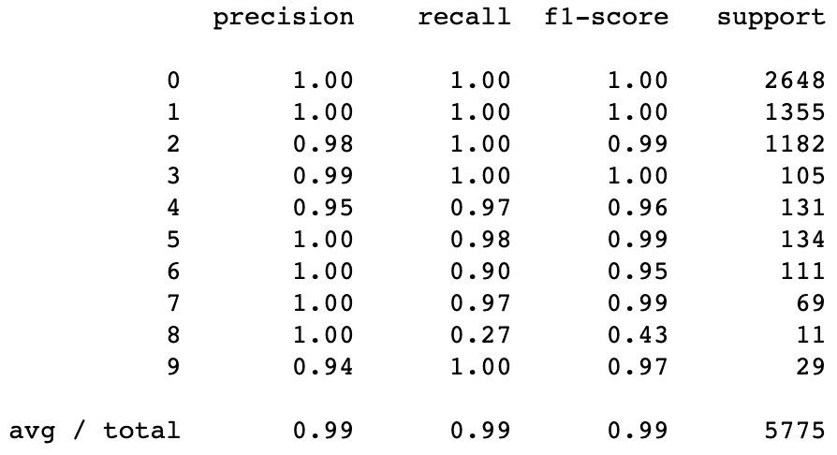
Transfer Learning ResNet50 Metrics
Metoprolol Succinate
Omeprazole
Metformin

Slide 15
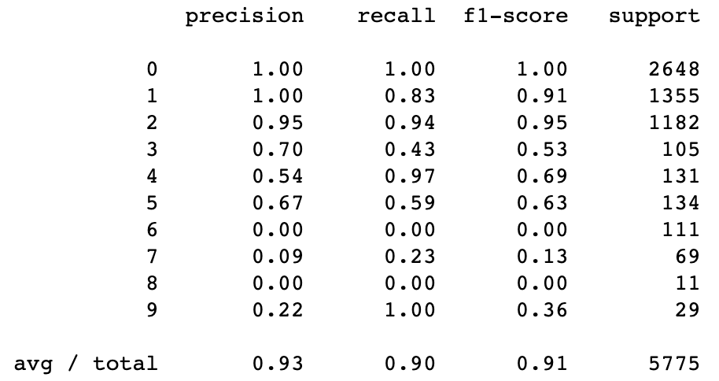
Transfer Learning VGG16 Metrics
Metoprolol Succinate
Omeprazole
Metformin

Slide 16
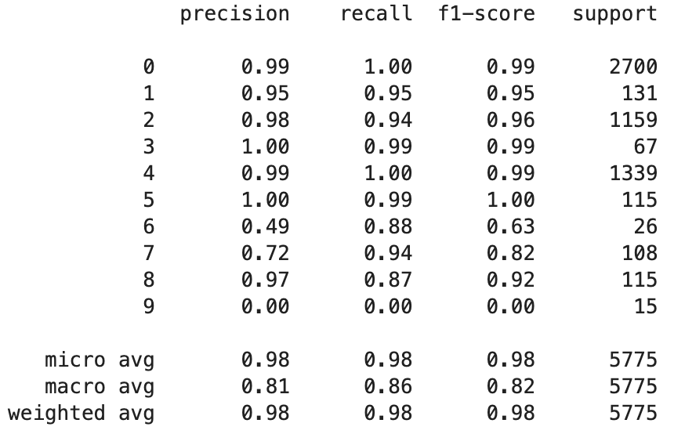
Categorical CNN Metrics
Metoprolol Succinate
Metformin
Omeprazole

Slide 17
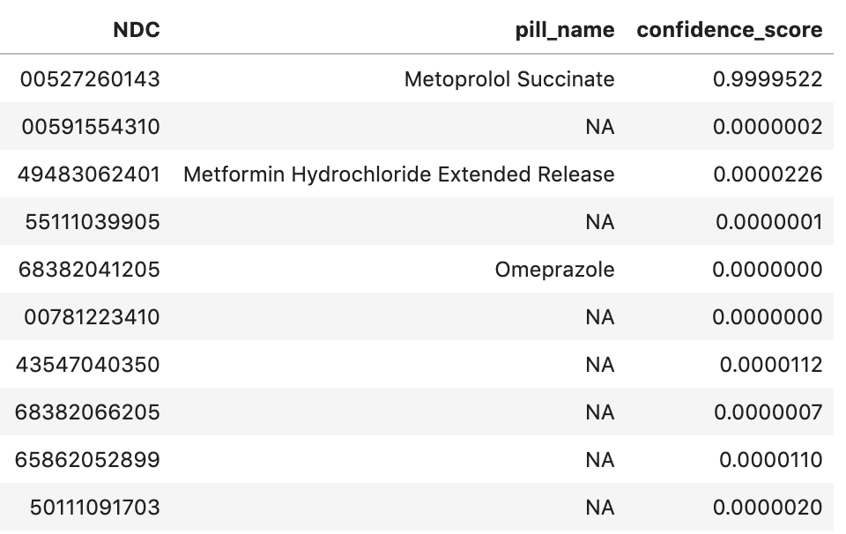
Example Prediction from Categorical CNN
Input
Output

